Slide 1
Employee Retirement Plan Committee Mtg
Brian McCleary
4/8/24
2023 Employee Plan Review

Slide 2
The Employee Retirement Plan Committee
The Employee Retirement Plan Committee is a standing committee comprised of the Chair of the Board, Vice Chair, Finance Committee Chair, General Manager acting as the Plan Administrator, Treasurer/CFO, Controller, and the Employee Representative. The Plan Administrator shall be the chairperson of the committee, and the committee shall meet at least annually to review the activities of the Employee Retirement Plan.

Slide 3
Agenda
Call to order by Plan Administrator – Alan Packard
Consider approval of minutes of the Employee Retirement Plan meeting held April 10, 2023
Report on the 2023 Employee Retirement Plan
Review Fund Actions taken in 2024
Consider allocation of Forfeitures and Revenue Credit Program Balances
Adjourn

Slide 4
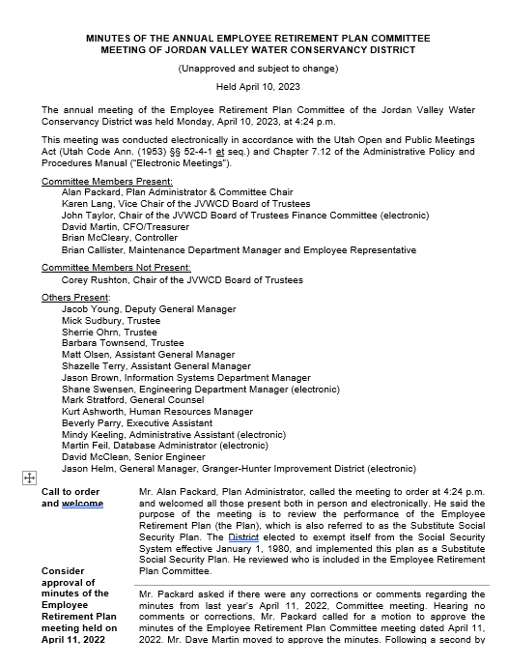
Minutes of Employee Retirement Plan meeting April 10, 2023

Slide 5
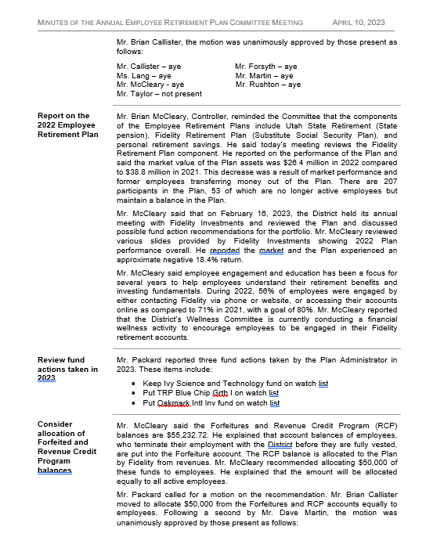
Minutes of Employee Retirement Plan meeting April 10, 2023 - continued

Slide 6
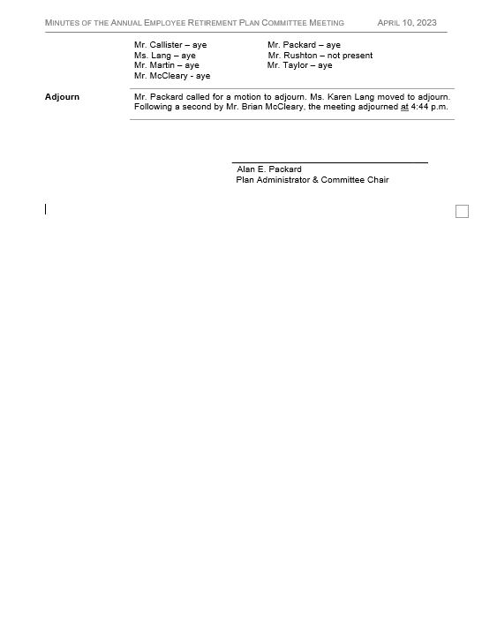
Minutes of Employee Retirement Plan meeting April 10, 2023 - continued

Slide 7
Report on the 2023 Fidelity- Employee Retirement Plan -
Substitute Social Security Plan

Slide 8
Three-Legged Stool of EE Retirement
Utah State Retirement (URS)
Fidelity – Employee Retirement Plan - Substitute Social Security Plan - Defined Contribution Plan
Utah State Retirement
Personal Retirement Savings
Fidelity – EE Retirement Plan
Employee Personal Retirement Savings

Slide 9
2023 Overall Return = 18.63%

Slide 12
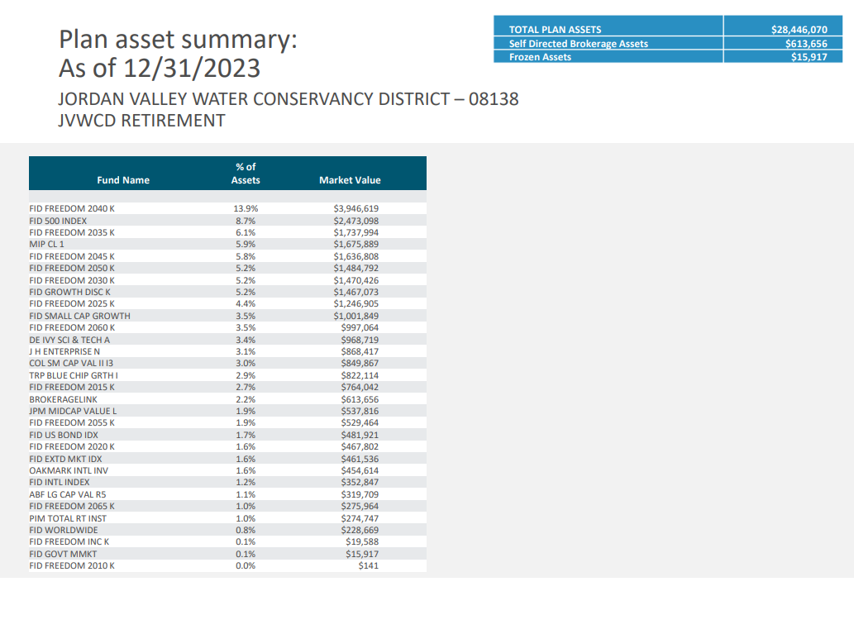

Slide 15
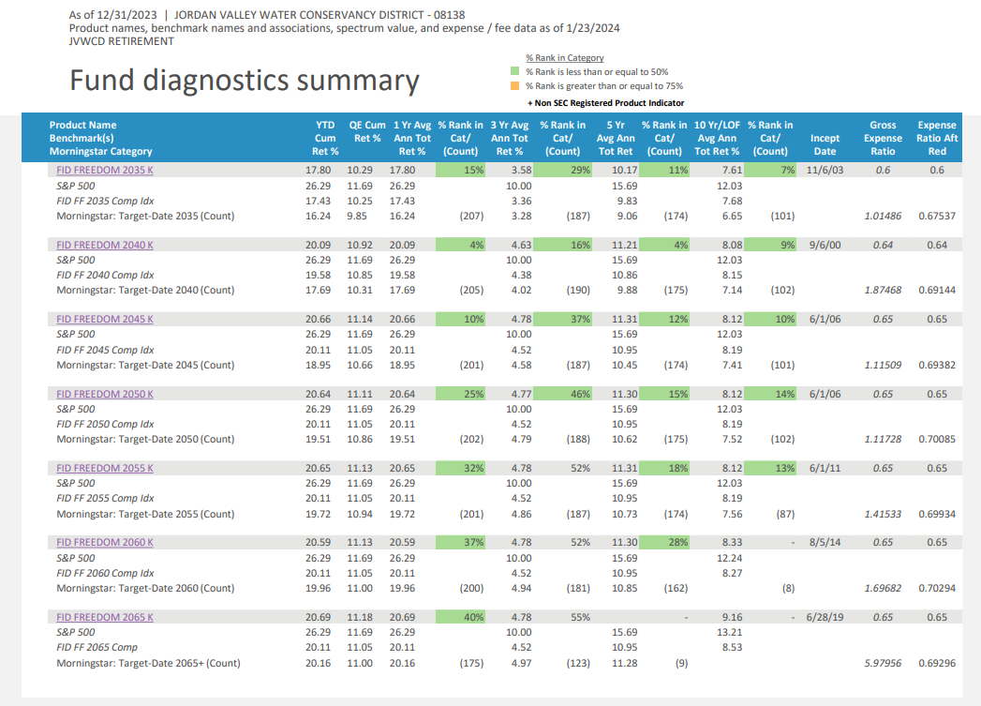

Slide 17
Fund Actions Recommended to take in 2024
Keep DE Ivy Sci and Tech on the Watch List
Keep Oakmark Intl Inv on Watch List
Keep TRP Blue Chip Grth I on Watch List
Offer Guaranteed Income Direct

Slide 18
Consider allocation of Forfeitures and Revenue Credit Program Balances
Forfeiture Account Balance is $24,833.24
Revenue Credit Program Balance is $13,363.67
Total Forfeiture and RCP = $38,196.91
Recommend allocating to Employees $37,000
$24,000 from Forfeitures & $13,000 from Revenue Credit Program

